Slide 1
Media Server
Ahmed Hesham

Slide 2
What Are Media Servers?
Media Servers are storage servers that house the media of the application in a decentralized manner
They are typically replicated to allow for faster content provision without having bottlenecks in a geographical region

Slide 3
Networked Storage
A network must exist to allow for server communication
High speed communication mediums are required to enable swift querying of media
Common storage forms:
  Network Attached Storage
  Storage Area Network

Slide 4
Network Attached Storage (NAS)
This a file level storage device attached over a TCP network
Appears as a shared folder on the OS
Uses Ethernet as the connection medium
Offers a simple management interface but at the cost of less features and cost

Slide 5
NAS Use Cases
File storage and sharing
Low volume unstructured data such as emails, photos, videos, etc.

Slide 6
Storage Area Network (SAN) – I
A dedicated block-level storage connected using high speed connections such as fiber optics
Uses dedicated protocols for accessing disks mostly Small Computer System Interface (SCSI) which provides low latency disk access
More expensive to manage

Slide 7
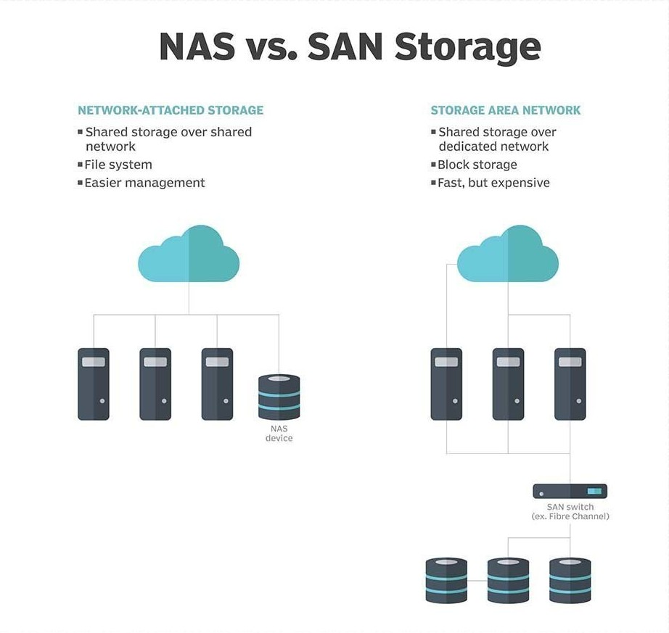
Storage Area Network (SAN) – II
Appears to the OS as a locally attached disk
Requires a dedicated switch to access storage

Slide 8
SAN Use Cases
Structured data such as database files, virtual machine storage
High volume data

Slide 9
Object Storage
A new form of storage is Object Storage
Manages data as objects rather than files or blocks
Data is stored along with metadata tags and a unique ID
Data is stored in a flat address space, that may be grouped into buckets
Objects are accessed through HTTP/REST interfaces

Slide 10
Object Storage – II
Designed to overcome the scalability limitations of NAS and the high costs of SAN
Decouples existing file system from the storage layer, thereby only monitoring high level abstracts only
Allows for data recovery using Erasure Coding, in which files are fragmented on multiple servers and encoded to allow for easier recovery

Slide 11
Ceph
An open source, object storage and block storage module designed to run in the Linux kernel
Built for commodity hardware rather than high end hardware
Built as layers to support multiple endpoints

Slide 12
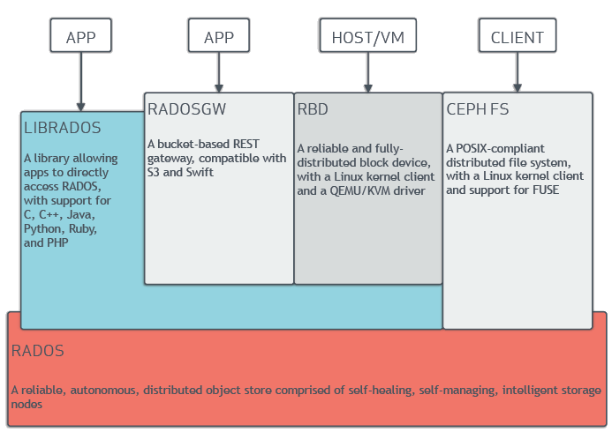
Ceph Layers

Slide 13
Ceph Storage Cluster
Ceph stripes the data across the clusters in a fashion similar to RAID 0 to achieve higher throughput
Striping is achieved using an algorithm called CRUSH (Controlled Replication Under Scalable Hashing)
CRUSH allows clients to communicate with the nodes to find files rather than having a dedicated server that keeps track of files

Slide 14
Ceph Storage Cluster – II
CRUSH keeps a map of the object store devices and the buckets (group of objects) they carry
This map is replicated on the nodes such that they can respond to queries individually
CRUSH then distributes the data in a pseudo-random manner across the nodes

Slide 15
Any questions?

